Slide 1
A Look at K-12 Public Education
Dr. Steven R. Staples
Superintendent of Public Instruction
House Committee on Education Summit
November 11, 2014

Slide 2
School Accreditation

Slide 3
Accreditation Process
Annual accreditation based on:
  Compliance with pre-accreditation eligibility requirements of Standards of Accreditation (SOA), reported by principals and superintendents
  Achievement of school accountability requirements of SOA based on Standards of Learning (SOL) tests pass rates and, for high schools, benchmarks for graduation
Notes:
Preaccreditation requirements are spelled out in the SOA at 8VAC20-131-280 F. and include offering courses that will allow students to complete graduation requirements; meeting the instructional program prescribed in the SOA, as well as meeting leadership and staffing requirements and facilities and safety provisions. Superintendents report compliance.

Slide 4
Benchmarks for Fully Accredited Ratings Awarded in the 2013-2014, 2014-2015 and 2015-2016 School Years (Based on Testing and Graduation Rate Data from the 2012-2013, 2013-2014 and 2014-2015 School Years)
Subject | Grade 3 | Grade 4 | Grade 5 | Grades 6 to 12
English | 75% | 75% | 75% | 75%
Mathematics | 70% | 70% | 70% | 70%
Science |  |  | 70% | 70%
History/Social Science |  | 70 percent at Grade 4 or 5 |  | 70%
Graduation and Completion Index (for schools with a graduating class) |  |  | 85 pts./82 pts.* | 2013-2014
 |  |  | 85 pts./83 pts.* | 2014-2015
 |  |  | 85 pts./84 pts.* | 2015-2016
*Benchmarks for Provisionally Accredited – Graduation Rate. This rating will no longer be awarded after the 2015-2016 School Year.

Slide 5
Schools Not Fully Accredited
2002-2003 until 2014-2015
567
2014-15

Slide 6
School Accreditation Ratings
Fully Accredited: Meets all benchmarks for achievement levels
Accredited with Warning: Adjusted pass rates for a core subject(s) is below benchmark or failed to meet minimum threshold for graduation and completion index
Accreditation Denied: Failed to meet the requirements for full accreditation for four consecutive years
Conditionally Accredited: New school or reconstituted school (awarded to a school that fails to meet full accreditation requirements for four consecutive years and receives permission from the Board of Education to reconstitute)

Slide 7
Accreditation 2014
Sixty-eight percent, or 1,246, of Virginia’s 1,827 public schools are rated as Fully Accredited for 2014-2015, compared with 77 percent for 2013-2014, and 93 percent for 2012-2013.
The number of schools Accredited with Warning rose to 541, an increase from last year’s total of 393. The drop in accreditation came despite statewide improvements in mathematics performance and hundreds of schools that also saw incremental gains in reading, writing and science.
Thirteen schools in six divisions are denied state accreditation for 2014-2015 because of persistently low student achievement.

Slide 8
2014-2015 Accreditation Ratings
Accreditation Rating | Number of Schools | Percent of All Schools
Fully Accredited | 1,249 | 68%
Accredited with Warning | 541 | 30%
Accreditation Denied | 13 | <1%
Provisionally Accredited | 2 | <1%
Conditionally Accredited (New Schools) | 10 | <1%
Conditionally Accredited (Reconstituted Schools) | 11 | <1%
To Be Determined | 0 | 0%
Total Schools | 1,826 | 100%

Slide 9
Focus on Challenged Schools

Slide 10
Federal and State Accountability Systems
Support and interventions from VDOE under the federal Elementary and Secondary Education Act (No Child Left Behind) is focused on Virginia’s lower and lowest-performing Title I schools, including those missing annual measureable objectives (AMOs) for narrowing achievement gaps.
Support and interventions to schools not fully accredited under the state accountability system are graduated depending upon the number of years of failure to achieve full accreditation, including years of Accreditation with Warning status.

Slide 11
Actions Prior to Denied Status
Academic review by an external team, with focus on curriculum alignment and engagement of school division leadership in process
Development and monitoring of a school improvement plan
Assignment of external contractor to school to guide actions and support building level efforts
Ongoing technical assistance and professional development in instruction and assessment
Monthly monitoring by VDOE Office of School Improvement and external contractor

Slide 12
Some Success
As a result of testing results in 2013-14, 74 schools exited Accreditation with Warning status in 2014-2015.

Slide 13
Conditionally Accredited Schools
A rating of Conditional Accreditation may be granted by the Board of Education to schools that would otherwise be denied accreditation. The school divisions must agree to “reconstituting” the school’s governance, its instructional program, its staff, or the student population.
For 2014-2015, the superintendents of all schools granted a rating of conditional accreditation must enter into a collaboratively developed Conditional Accreditation Agreement with the Superintendent of Public Instruction. The agreement outlines Essential Actions that must be completed based on specific needs of the school.

Slide 14
13 Schools Denied Accreditation for 2014-15
As required by the Standards of Accreditation, the Virginia Board of Education and local school board enter into a Memorandum of Understanding (MOU) based on the needs of the school.
For 2014-2015, prior to the development of each MOU, OSI staff met with the superintendent of each denied schools to identify areas in which the school needed support. Using this information, the MOUs were customized for each school.
A corrective action plan that specifies the actions that must be taken to improve the performance of the school is developed based on the MOU.
Quarterly meetings are held to discuss progress in addressing the essential actions included in the corrective action plan.

Slide 15
Next Steps
Focus on attracting and retaining quality teachers in struggling schools
Continued focus on improving quality of instruction in classroom and the capacity of principals to provide helpful feedback to teachers
Emphasis on providing “wrap around” services for students

Slide 16
Challenges and Obstacles to a Focus on School Improvement

Slide 17
Virginia General Assembly Mandates for Board of Education, VDOE, and School Divisions
2011-2014
Year VDOE/BOE School Divisions
2011 3 11
2012 16 9
2013 15 18
2014 13 16
Total 47 54
Notes:
Executive Order 58 (2007) defines mandates and includes compulsory orders, actions that impose requirements and regulation of optional activities, not mandated but subject to regulation if performed.
Examples of requirements for VDOE/BOE:
CTE - Certification a mandatory part of CTE program for automotive technology where national certification. (2011)
Autism - Training standards for school divisions’ use. (2012)
A to F Grading System – For individual school performance. (2013)
Model Policy for Bullying to be developed by the Board (2013)
SOL – Guidelines for local school division use in areas where SOL assessments not administered.(2014)
Examples of requirements for school divisions:
Virtual Virginia –In every school division. (2011)
Autism – Training for certain paraprofessionals. (2012)
Targeted Mathematics Remediation – Certain students in grades six though eight. (2013)
Threat Assessment Teams to be established (2013)
Teacher licensure – Initial licensure in any CTE area to also include industry certification credential. (2014)
Development of assessments in previously tested Standards of Learning areas (2014)

Slide 18
Educational Challenges
Overall, student enrollment has increased by 2.5 percent statewide since 2008.
In the last five years:
  the number of economically disadvantaged students has grown from 34 to 41 percent of Virginia’s public school students.
  English Language Learners in Virginia have grown to 95,000, an increase of 15 percent.
  The percentage of students with the most need for intensive special education, such as autism and other health impairments, has grown by 23 percent to 46,865.

Slide 19
Educational Challenges continued
Gaps between economically disadvantaged students and peers have grown as much as 35 percentile points on NAEP reading and mathematics scores.
Subgroups of students, such as Economically Disadvantaged, English Language Learners, and Special Education, require more intensive interventions and more resources to teach.
Notes:
In the last five years, the number of economically disadvantaged students has grown to 41 percent of all Virginia’s public school students. In the same time period, the number of English Language Learners has grown to 95,000—an increase of 15 percent. The number of students identified as needing special education has declined by 3.5 percent in the last five year years; however, the number of students identified as needing special education have disabilities, such as autism, which are the most expensive to serve.

Slide 20
Educational Challenges continued
In FY 2014, General Fund Direct Aid to Public Education is $308,616,613 less than it was in FY 2007.
Since 2008, K-12 public education staffing has been reduced by 5,000 positions in Virginia. The top critical shortage area among endorsed teachers is Special Education.

Slide 21
VDOE Staffing
Notes:
A reduction of 62 positions from 2008 to 2014

Slide 22
Despite these obstacles and challenges, Virginia Fares Well…
Student
Achievement:
Virginia & the Nation

Slide 23
Virginia & NAEP
Percent Proficient or Above
Grade-4 Reading

Slide 24
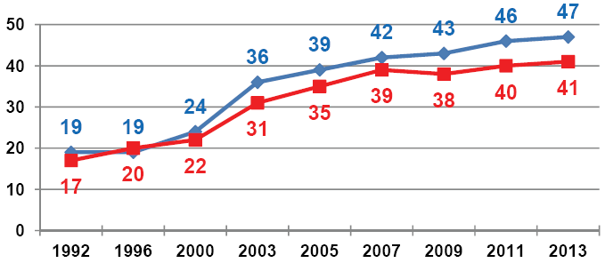
Virginia & NAEP
Percent Proficient or Above
Grade-4 Mathematics

Slide 25
Virginia & NAEP
Percent Proficient or Above
Grade-4 Science

Slide 26
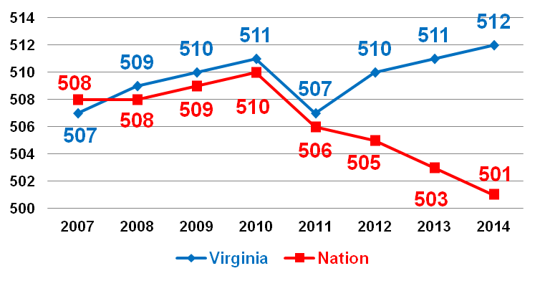
SAT:
Mathematics Mean Scaled Scores

Slide 27
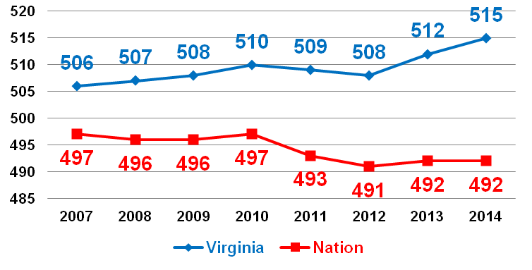
SAT:
Reading Mean Scaled Scores

Slide 28
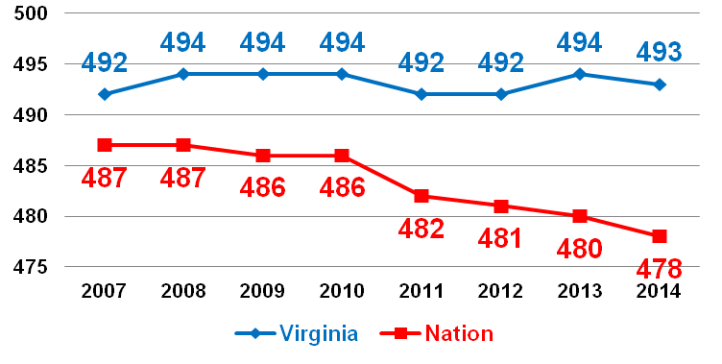
SAT:
Writing Mean Scaled Scores

Slide 29
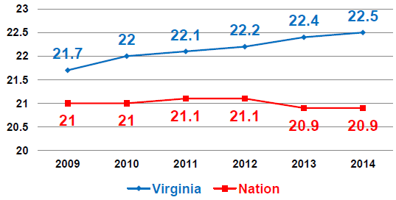
ACT (College Readiness Benchmarks):
Mathematics

Slide 30
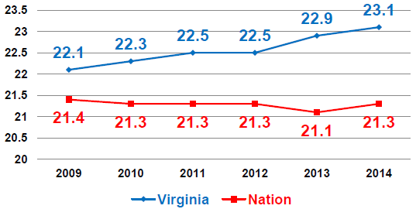
ACT:
Reading

Slide 31
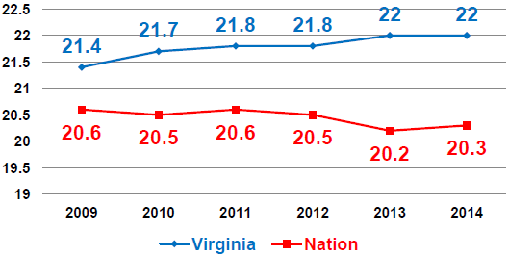
ACT:
Grammar & Usage

Slide 32
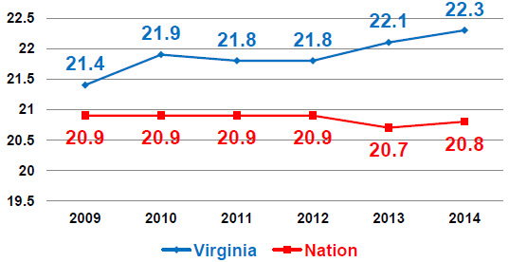
ACT:
Science

Slide 33
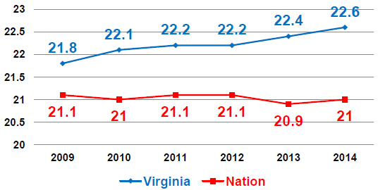
ACT:
Composite

Slide 34
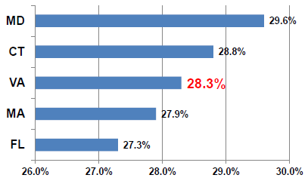
Advanced Placement
2013 Graduates with Qualifying Scores

Slide 35
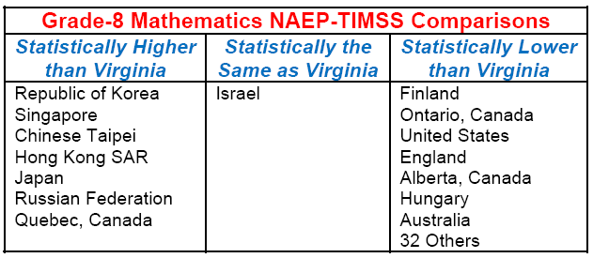
2013 NAEP-TIMSS Linking Study
Mathematics

Slide 36
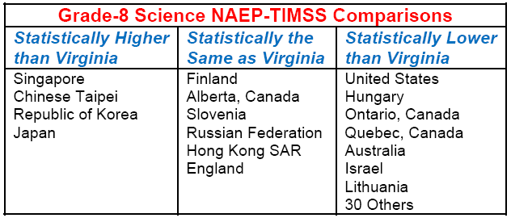
2013 NAEP-TIMSS Linking Study
Science

Slide 37
SOL Innovations Committee
Created in 2014 legislative session through HB 930 and SB 306 and signed by the Governor on April 4, 2014
Established by Secretary of Education, staffed by VDOE
Examining “next steps” for accountability reform that maintains positive gains of current system but responds to changing needs

Slide 38
In 1995
The cost of a gallon of gas is $1.09 per gallon.
Microsoft releases Windows 95 and the first version of Internet Explorer.
18 million American homes are online, but only 3 percent of online users have ever signed on to the World Wide Web.
The iPhone is not yet invented.
The SOL and Accountability Reform System begins in Virginia.

Slide 39
Consideration and Opportunities for “Accountability 2.0”
How can the next phase:
  drive improvement as well as identification?
  account for “moving toward”, “meeting” and “exceeding” standards?
  identify areas in which schools are struggling?
  drive “equity” for schools with high percentages of children in poverty?
What is the appropriate “failure point” for consequences?
What is the appropriate “pace of changes” to the standards & tests?
What is the course of action if Virginia reforms do not align with federal accountability?

Slide 40
Expansion of Learning Opportunities:
Virtual Virginia

Slide 41

Slide Title
Notes:
As a program of the Virginia Department of Education, Virtual Virginia offers online Advanced Placement (AP®), world language, core academic, and elective courses to students across the Commonwealth and nation. Virtual Virginia is committed to providing high-quality, rigorous course content with flexibility to meet the varied schedules and needs of schools and students.

Slide 42

Mission
Program of the Virginia Department of Education serving students in middle and high schools
Offers equitable access to online courses for students who might not be able to take Advanced Placement, world language, core academic, and elective courses due to the lack of a highly-qualified instructor, too few students to offer the course, or scheduling conflicts within the school
Notes:
Virtual Virginia works with Virginia public schools to provide students access to courses that are unavailable to them due to low enrollments, scheduling conflicts, and the lack of highly qualified teachers. Virtual Virginia ensures the availability of high quality and rigorous Advanced Placement and world language courses to underserved populations and provides equitable access to educational options throughout Virginia.

Slide 43
Courses and Curriculum
Aligned to Virginia’s Standards of Learning
Authorized by the College Board
Includes readings, discussion forums, written assignments, media, student presentations and projects, case studies, simulations, virtual lab assignments, models, interactive assignments, and opportunities for collaboration
Currently offers 54 courses
Notes:
Courses are delivered via the Internet through a secure, Web-based environment; students may participate at school or at home. The courses promote a high level of interaction among students and teachers.
Virtual Virginia courses meet Virginia’s Standards of Learning. All Advanced Placement courses are audited and approved by the College Board as well as the National Collegiate Athletic Association (NCAA).

Slide 44
Technical Infrastructure
Web-based learning management system (BrightSpace)
Communication hardware and software
Technical support for schools, including helpdesk

Slide 45
Instruction
Synchronous and asynchronous
Available 24/7
Teachers are facilitators, learning managers, and tutors
Notes:
Although all content, media, and interactives are available asynchronously, Virtual Virginia teachers provide synchronous instruction via virtual classroom tools, web conferencing, LMS-system tools, and Skype. The teachers keep regular office hours based on full-time or adjunct status, ensuring that our students, parents, and school staff receive prompt attention.

Slide 46
Teachers
66 Highly-qualified teachers
Licensed in Virginia
Endorsed in subject area
Trained in providing online instruction
Average student-teacher ratio is 109:1
Notes:
Virtual Virginia teachers are all licensed in Virginia and highly-qualified—endorsed in their respective content areas. VVa teachers receive training in online instruction and pedagogy as well as professional development around teaching Advanced Placement courses. Teachers are observed and evaluated several times each year using a program based on the iNACOL standards for quality online instruction.

Slide 47
Who Uses VVA Courses?

Slide 48
Advanced Placement Courses
^{Art History}
^{Biology}
^{Calculus AB}
^{Calculus BC}
^{Computer Science A}
^{English Language & Composition}
English Literature & Composition
^{Government and Politics: U.S.}
^{Human Geography}
^{Latin Literature}
^{Physics B}
^{Psychology}
^{Spanish Language}
^{Statistics}
^{U.S. History}
^{World History}
^{Chinese}
^{Environmental Science}
^{European History}
^{French Language & Composition}
Government and Politics: Comparative
^{Macroeconomics}
^{Microeconomics}

Slide 49
Standard Courses
^{Arabic I}
^{Arabic II}
^{Arabic III}
^{Astronomy}
^{Chemistry}
^{Chinese I}
^{Chinese I}
^{Chinese III}
^{Chinese IV}
^{Creative Writing}
^{Earth Science I}
^{Earth Science II: Astronomy}
^{Economics & Personal Finance}
Intro to Game Design & Development
^{Latin I}
^{Latin II}
^{Latin III}
^{Latin IV}
^{Physics (Honors)}
^{Pre-Calculus & Math Analysis}
^{Introductory} ^{Spanish}
^{Beginning Spanish}
^{Intermediate Spanish}
^{Advanced Spanish}
Survey of World Languages & Cultures
^{World History I}
^{World Mythology}

Slide 50
Fiscal Year 2013-2014
Notes:
Cost per student enrollment $421

Slide 51
Next Steps
Broadband : Access and speed for school divisions
Learn24VA: Access to content for students and teachers through a Web portal
Virtual Textbook Marketplace and Resource Center: Access to electronic textbooks, chapters, tests, resources
Notes:
Broadband Access – The Federal Communications Commission has committed $1 billion dollars, through the E-Rate program, to assist schools and libraries in obtaining affordable access to higher broadband speeds. The Education Superhighway is collecting data on prices paid by schools in Virginia for broadband access.
LearnVA24 – A Web portal that provides educational resources to teachers in a variety of content areas.
Copia – Copia has been awarded a VITA contract to offer a Virtual Textbook Marketplace and Resource Center. Copia Interactive, LLC is able to offer a virtual textbook marketplace and resource center where commonwealth school personnel and students can purchase:
Electronic textbooks
Individual sections/chapters of electronic textbooks
Supplemental resources (handouts, chapter reviews and quizzes)
And other offerings by various content providers/publishers(videos)

Slide 52
Questions or Comments?

